Slide 1
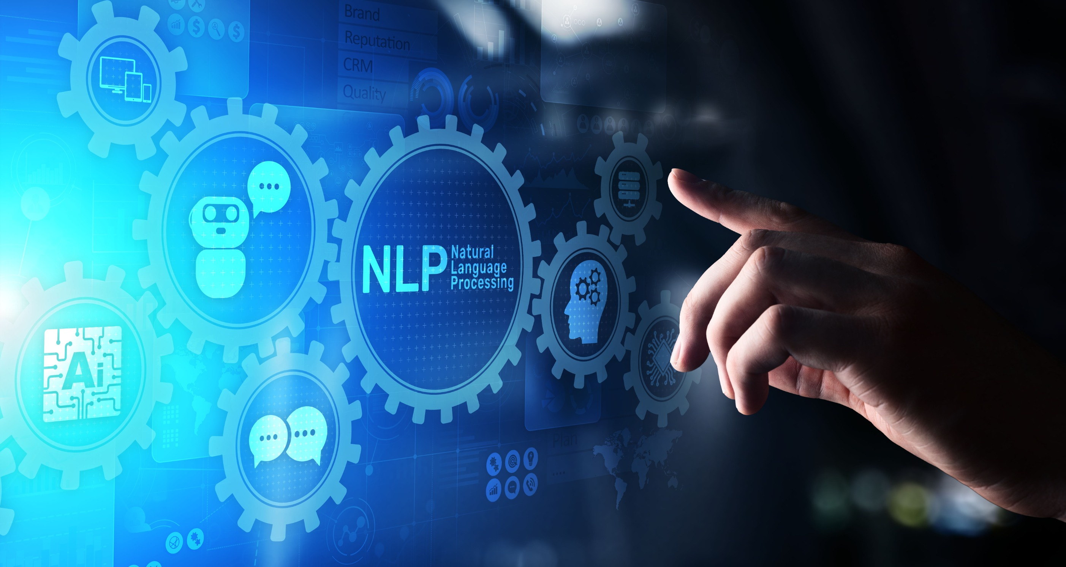

Automatic Text Summarization Using a Transformer-Based T5 Model
DSA0306 – Natural Language Processing
Faculty Dr. Kumaragurbaran. T
Dept. of CSE
SIMATS Engineering
CHALLA RAVITEJA 192325065
T. Madhu Charan 192472230
T. Jyothi Reddy 192472079
V. Naga Nischay 192472255
A. Satya Manoj 192425370

Slide 2


ABSTRACT
This project is an Automatic Text Summarization System that uses the Transformer-based T5 model to generate short and meaningful summaries from long text documents. The system understands the important information in the input text and produces a clear summary while preserving the original meaning. This helps users save time and quickly understand lengthy documents such as articles, reports, and research papers.
Modules:
Module 1: Advanced Preprocessing and Tokenization
Module 2: Fine-Tuning T5 for Domain-Specific Summarization
Module 3: Multi-Document and Long-Text Summarization
Module 4: Deployment and Real-Time API Integration

Slide 3
INTRODUCTION
Text summarization is an important application of Natural Language Processing (NLP).
Many documents such as news articles, research papers, and reports contain large amounts of information.
Reading the complete document takes time and effort.
This project uses the Transformer-based T5 model to generate short and meaningful summaries automatically.
The generated summary helps users understand the main points quickly without reading the entire document.

Slide 4
PROBLEM STATEMENT
Reading long documents takes more time and effort.
Important information is difficult to identify quickly.
Manual summarization is time-consuming.
Automatically generates short and meaningful summaries.
Identifies the important information from the document.
Reduces reading time for users.

Slide 5

OBJECTIVES
To develop an automatic text summarization system using the T5 Transformer model.
To generate short and meaningful summaries from long documents.
To reduce the time required to understand large amounts of text.
To improve summary quality using the Transformer-based T5 model.

Slide 6
LITERATURE REVIEW
Year | Title of the Paper | Objectives | Limitations
2022 | Text Summarization Using Deep Learning | Generate summaries using deep learning models. | Summary quality depends on the dataset.
2023 | Transformer-Based Abstractive Summarization | Improve summary quality using Transformer models. | Requires high computational resources.
2024 | T5 Model for Automatic Text Summarization | Generate fluent and meaningful summaries using T5. | Performance decreases for very long documents.
2025 | Intelligent NLP-Based Text Summarization | Produce accurate summaries using advanced NLP models. | Needs continuous model improvement for better accuracy.

Slide 7
METHODOLOGY
The user uploads or enters a text document.
The system cleans, chunks, and tokenizes the input text.
The T5 Transformer model analyzes the document.
The model generates a meaningful , domain-relevant summary.
The generated summary is evaluated and displayed to the user.

Slide 8
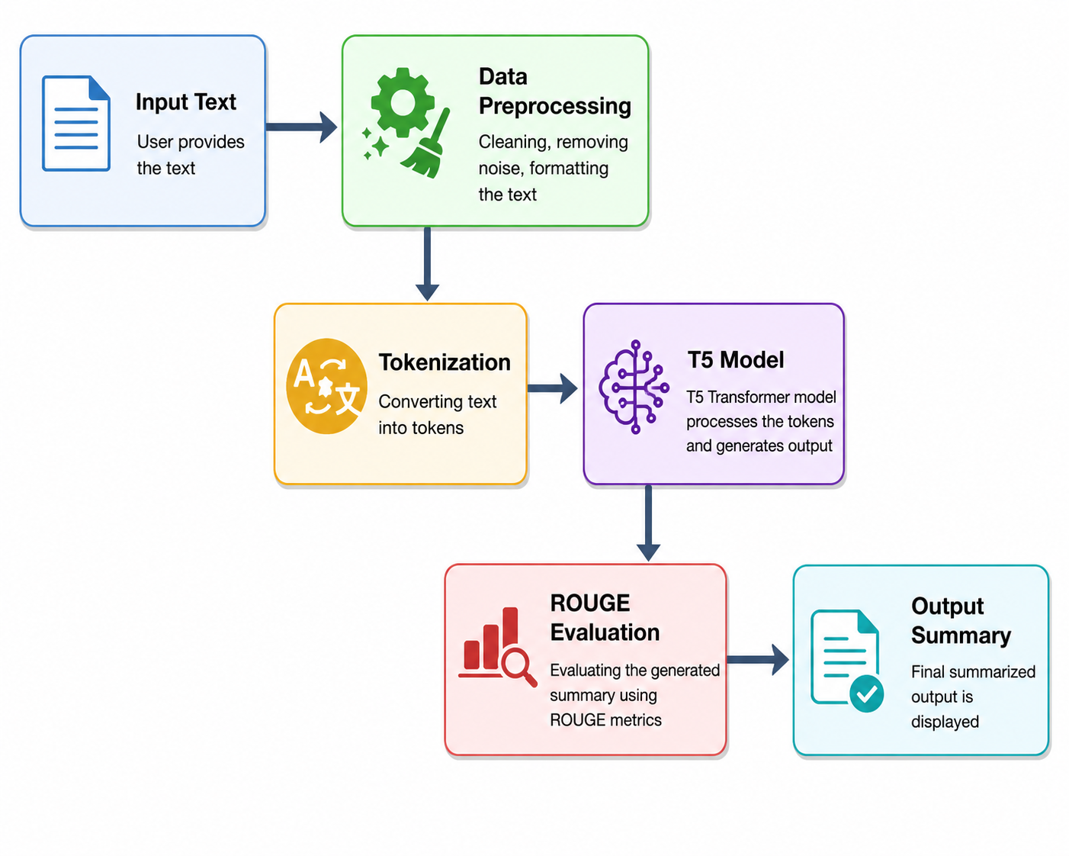
SYSTEM ARCHITECTURE

Slide 9
Module 1: Advanced Preprocessing and Tokenization
Long documents are split into smaller, manageable chunks before processing.
Text is cleaned by removing noise, special characters, and extra spaces.
Sentence boundaries are detected to preserve meaning during chunking.
The T5 tokenizer converts cleaned text into token sequences.
Chunk overlap is applied to retain context between adjacent segments.

Slide 10
Module 2: Fine-Tuning T5 for Domain-Specific Summarization
The pretrained T5 model is fine-tuned on domain-specific datasets.
Fine-tuning helps the model learn vocabulary specific to the target domain.
Hyperparameters such as learning rate and batch size are optimized.
Transfer learning reduces the data and time needed for training.
The fine-tuned model produces summaries that better match domain needs.

Slide 11
Module 3: Multi-Document and Long-Text Summarization
Multiple related documents are combined into a single input.
The system identifies overlapping and redundant information across documents.
A unified summary is generated capturing key points from all sources.
Documents exceeding the model input limit are summarized in segments.
Segment summaries are merged into one coherent final summary.

Slide 12
Module 4: Deployment and Real-Time API Integration
The trained summarization model is packaged and deployed as a web service.
A REST API is created to accept text input and return summaries.
The API supports real-time requests with minimal response latency.
The system is containerized for consistent deployment across environments.
Authentication and rate-limiting are added to secure API access.

Slide 13
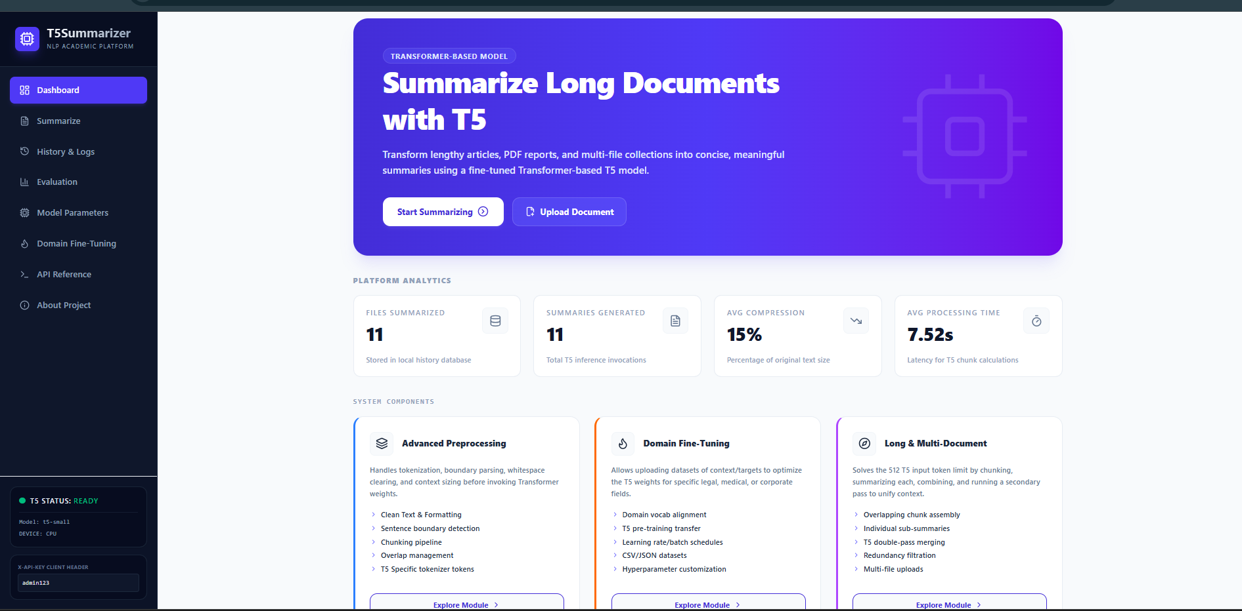
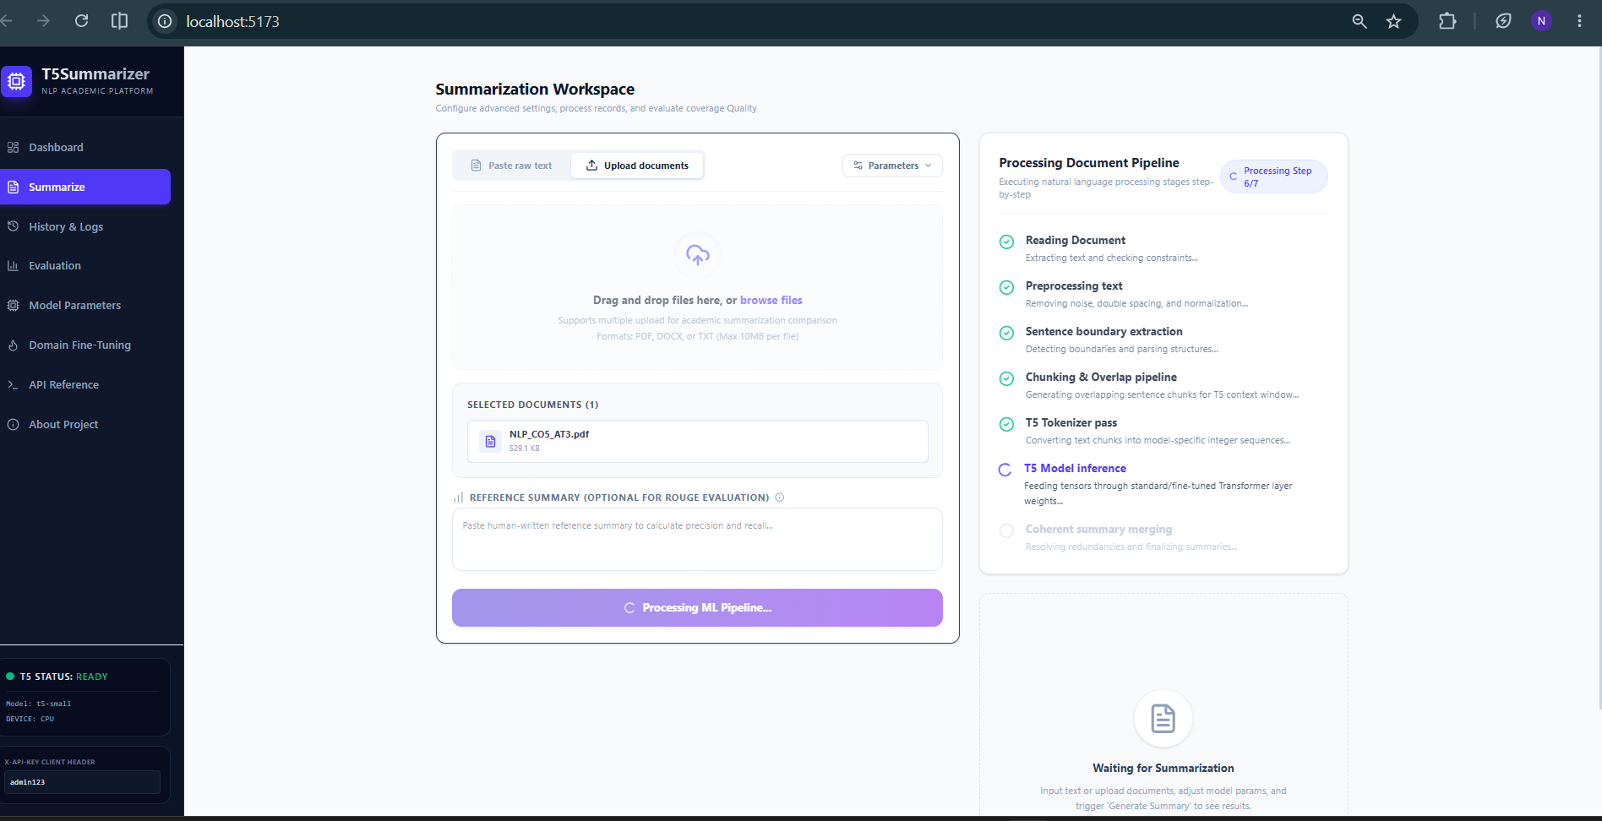
IMPLIMENTATION

Slide 14
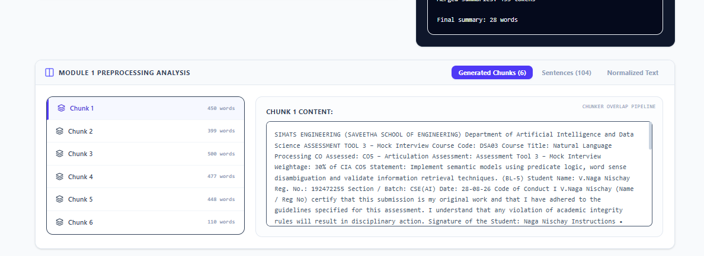
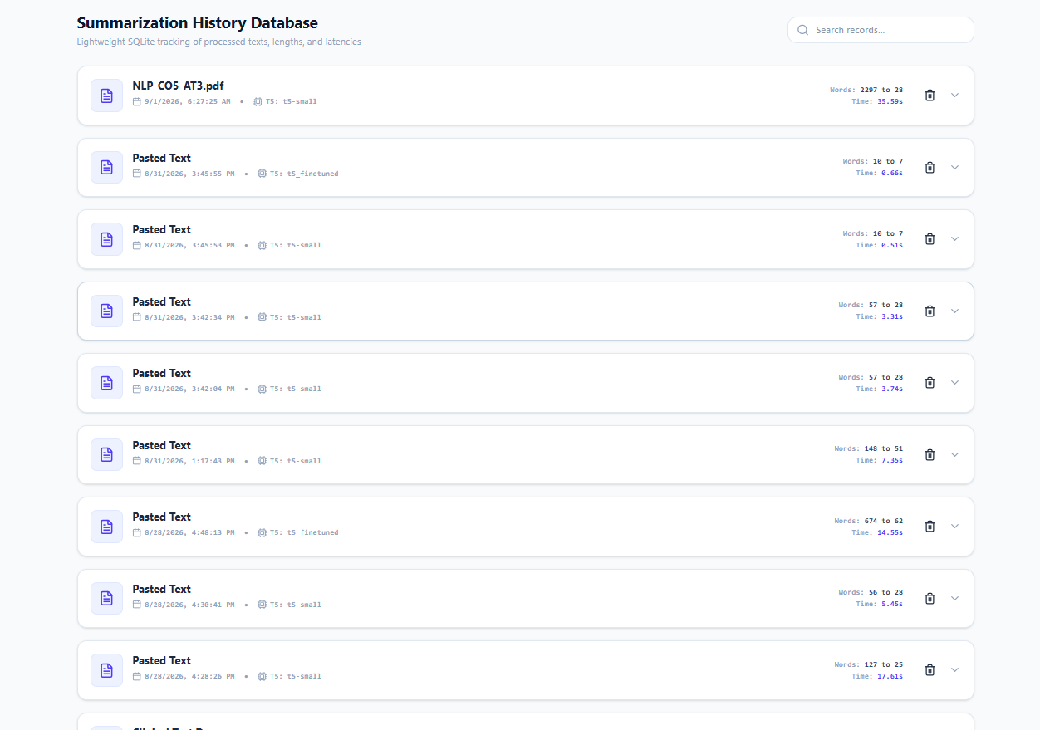
IMPLIMENTATION

Slide 15
RESULTS & DISCUSSION
The fine-tuned T5 model produced more accurate and domain-relevant summaries than the base model. ROUGE scores showed a noticeable improvement in summary quality after fine-tuning on domain-specific data.
Multi-document summarization successfully reduced redundant information across related sources. The advanced preprocessing module ensured longer documents were handled without losing important context.
The deployed API delivered summaries within a response time suitable for real-time use. Overall results confirm that the four new modules meaningfully improved the system's capability and usability.

Slide 16



CONCLUSION
The project successfully extends automatic text summarization with four new modules: advanced preprocessing, domain fine-tuning, multi-document summarization, and real-time API deployment.
Fine-tuning and improved preprocessing enabled the T5 model to generate more accurate, domain-appropriate summaries from longer and more complex documents.
Real-time API deployment made the system practical for real-world use, making the summarization pipeline more accurate, scalable, and usable overall.

